Slide 1


Socio-structural protection from self-stigma among South African adolescents living with HIV:
The potential of clinic-community collaborations for stigma reduction
Pantelic, M ^{1,2}; Moshabela, M ³; Cluver, L ^{2,4}; Toska, E ^{2,5,6}; Caswell, G ¹, Ronan A⁷
1 International HIV/AIDS Alliance; 2 Department of Social Policy and Intervention, Oxford University; 3 School of Nursing and Public Health, University of KwaZulu-Natal; 4 Department of Psychiatry and Mental Health, University of Cape Town; 5 AIDS and Society Research Unit, University of Cape Town; 6 Department of Sociology, University of Cape Town; 7 Pediatric Adolescent Treatment for Africa

Slide 2
INTERNALIZED HIV STIGMA:
URGENT NEED FOR EVIDENCE
  Internalised stigma:
  Hampers treatment
  Reduces quality of life
  No evidence on what works for children or adolescents!

Slide 3
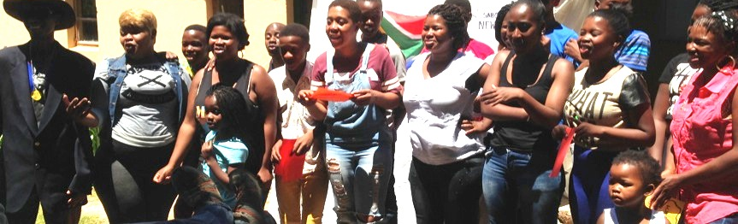
METHODS: BRINGING IN THE EXPERTS
An Eastern Cape health district, South Africa
Every adolescent ever initiated on ART
53 health facilities, all clinic files
Community-tracing
Standardised questionnaires

Slide 4
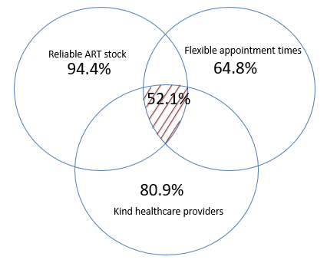
RESULTS

Slide 5
Socio-demographic co-factors
Younger age | 1.40 | 1.00 | 1.97
Female gender | 1.05 | .77 | 1.44
HIV status aware | 1.11 | .77 | 1.60
Community protection
No enacted stigma in the past 12 months | .38*** | .22 | .63
No community stigma | .40*** | .29 | .64
Clinic protection
Confidential clinic | .82 | .58 | 1.17
HIV support group | .96 | .62 | 1.49
Reliable ART stock | .40** | .23 | .72
Kind healthcare providers | .58** | .41 | .93
Flexible clinic appointments | .78* | .50 | .93
*** indicates p<.001; ** indicates p<.005; * indicates p<.05
85% reduction in self-stigma

Slide 6
